Slide 1
Chapter 6:
LabVIEW
Part 1: Introduction

Slide 2
Objectives
What is Data Acquisition and Why use it?
Overview of LabVIEW
  Develop an idea of what LabVIEW really is
  Learn what graphical programming language and
  dataflow mean
  Get a feel for the LabVIEW environment
Learning VI programming through example

Slide 3
What is Data Acquisition and Why use it?
Traditional Experiments – signals from sensors are sent to analog or digital meters, read by the experimenter, and recorded by hand
In automated data acquisition systems the sensors transmit a voltage or current signal directly to a computer via a data acquisition board.
Software such as LabVIEW controls the acquisition and processing of such data
The benefits of automated systems are many:
  Improved accuracy of recording
  Increased frequency with which measurements can be taken
  Potential to automate pre and post processing and build in quality control

Slide 4
Overview of LabVIEW
LabVIEW – Laboratory Virtual Instrument Engineering Workbench
Graphical programming language that allows for instrument control, data acquisition, and pre/post processing of acquired data

Slide 5
Graphical programming language
& Data flow
LabVIEW relies on graphical symbols rather than textual language to describe programming actions
The principle of dataflow, in which functions execute only after receiving the necessary data, governs execution in a straightforward manner.

Slide 6
How does LabVIEW work?
LabVIEW programs are called:
Virtual Instruments (VIs)
  because their appearence and operation imitate
  actual instruments.
However, they are analogous to main programs, functions and subroutines from popular language like C, Fortran, Pascal, …

Slide 7
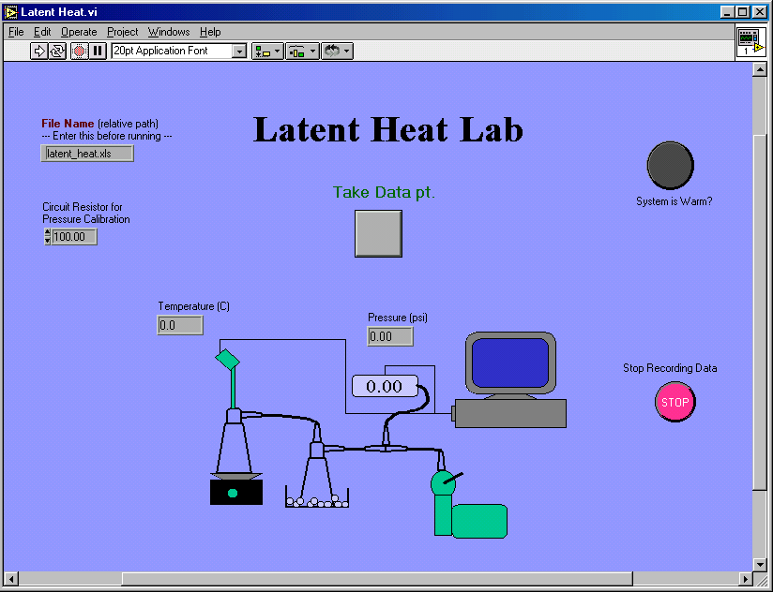
What does a VI look like?

Slide 8
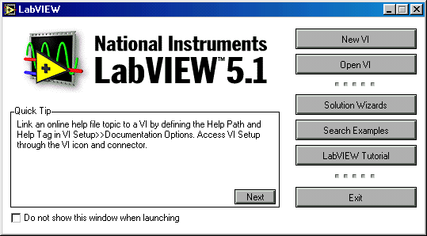
In LabVIEW you can create or use “virtual instruments” (VI) for
data acquisition. A VI allows your computer screen to act as an
actual laboratory instrument with characteristics tailored to your
particular needs.
You can also use built-in examples, or use standard templates
for setting up your data acquisition input channels.

Slide 9
A VI has three main parts:
The front panel:
an interactive user interface of a VI, so named because it can simulates the front panel of a physical instrument.
The block (or wiring) diagram:
    It is the VI’s source code, constructed in LabVIEW’s
    graphical programming language, G. It is the actual
    executable program.
    Subroutine in the block diagram of VI.
Icon/connector

Slide 10
Chapter 6:
LabVIEW
Part 2: The LabVIEW Environment

Slide 11
Objectives
Learn how the three main parts of the LabVIEW environment – the front panel, block diagram, and icon/connector – work together.
Learn the difference between controls and indicators & Be able to recognize their block diagram terminals.
Learn about the capabilities and uses of the toolbar, tools palette, controls palette, functions palette, and subpalettes.

Slide 12
Front Panels
Simply put, the front panel is
the window through which
the user interacts with the
program.
When you run a VI, you must have the front panel open so that you can input data to the executing program.
The front panel is where you see your program’s output.

Slide 13
Components of a front panel:
The front panel is primarily a
combination of controls and indicators.

Slide 14

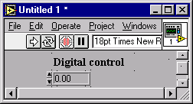
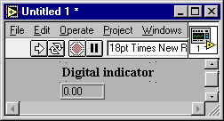
Control? or Indicator?
Controls = Inputs from the user = Source Terminals
Indicators = Outputs to the user = Destinations

Slide 15
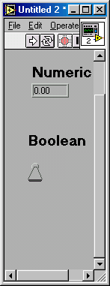
Manipulating Controls and Indicators
Right click on an indicator to
  Change to control
  Change format or precision
Right click on a control to
  Change to indicator
  Change mechanical action (whether to latch open or closed, and what to use as default…)

Slide 16
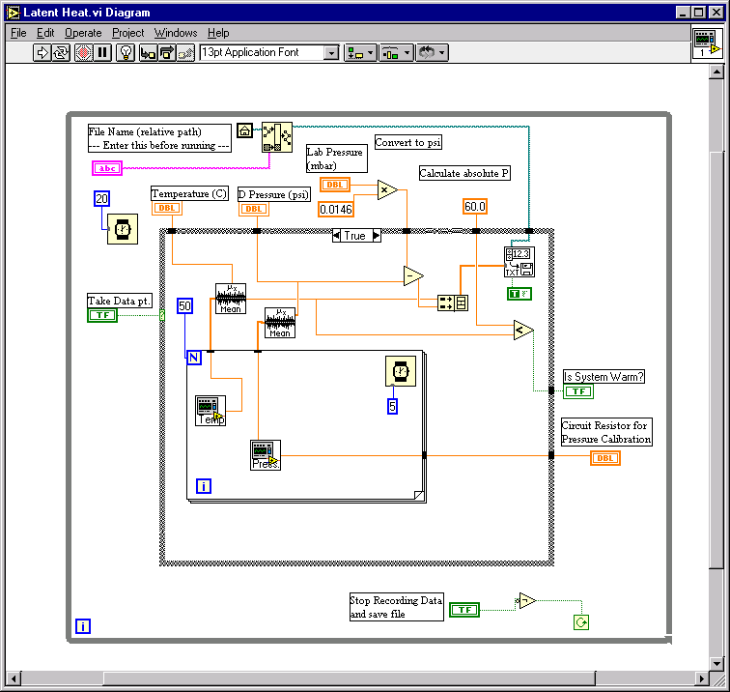
Block Diagrams
The block diagram window
holds the graphical source
code of a LabVIEW VI – it is
the actual executable code
You construct the block diagram by wiring together objects that perform specific functions.
The various components of a block diagram are terminals, nodes and wires.

Slide 17
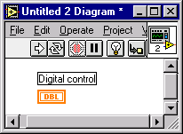
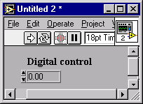
Terminals
When you place a control
(or indicator) on the
FRONT PANEL
LabVIEW automatically
creates a corresponding
control (or indicator)
terminal on the BLOCK
DIAGRAM

Slide 18
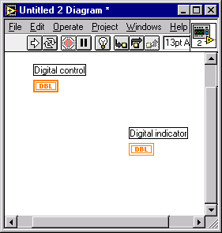
Control or Indicator
Terminal?
Control terminals have
thick borders
Indicator terminals have
thin borders

Slide 19
Deleting Block Diagram Terminals
?
Here !
By default, you cannot delete a block diagram terminal that belongs to a control (or indicator).
The terminal disappears only when you delete its corresponding control (or indicator) on the FRONT PANEL.

Slide 20
Nodes
Node is just a fancy word for a program execution element –
Nodes are analogous to statements, operators, functions and
subroutines in standard programming language:
The add and subtract functions represent one type of node.
A structure is an other type of node. Structures can execute code repeatedly or conditionally, similar to loops and case statements in traditional programming languages.
LabVIEW has also special nodes, called formula nodes, which are useful for evaluating mathematical formulas or expressions.

Slide 21
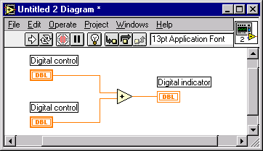
Wires
Wires
Node
A LabVIEW VI is held together by wires connecting nodes
and terminals; they deliver data from one source terminal to
one or more destination terminals.

Slide 22
Basic wires used in block diagrams and corresponding types
Each wire has different style or color, depending on the data
type that flows through the wire:
 | Scalar | 1D array | 2D array | Color
Floating-point number |  |  |  | orange
Integer number |  |  |  | blue
Boolean |  |  |  | green
String |  |  |  | pink

Slide 23
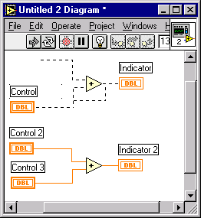
Broken wires
If you connect more than
one source or no source
at all to a wire,
LabVIEW
DISAGREES with what you’re doing, and the
wire will appear broken

Slide 24

Components of a block diagram
– Review ! –
Nodes: program execution elements
Terminals: Ports through which data passes between the block diagram and the front panel and between nodes of the block diagram
Wires: Data paths between terminals

Slide 25
Dataflow Programming – Going with the flow
Stated simply, a node executes only when data arrives at all its input terminals;
the nodes supplies data to all of its output terminals when it finishes executing;
and the data pass immediately from source to destination terminals.

Slide 26
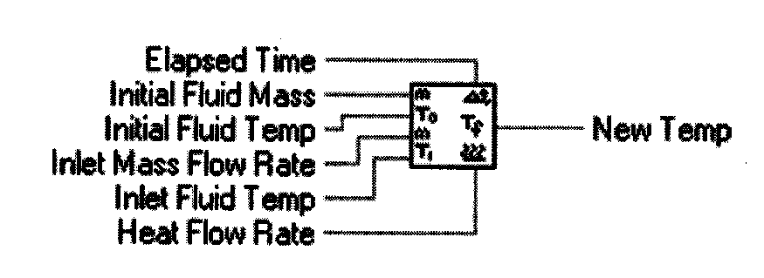
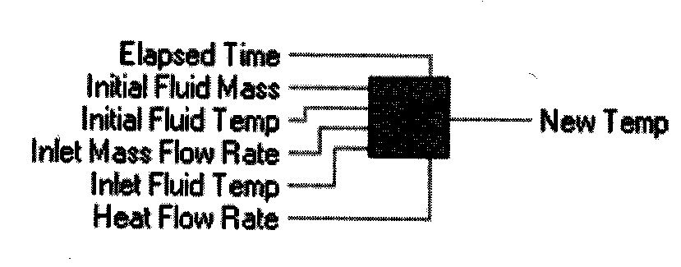
Icons and Connectors
The icons and connectors specify the pathways for data to flow into and out of VIs.
The icon is the graphical representation of the VI in the block diagram.
&
the connector defines the inputs and outputs
more on this later…

Slide 27
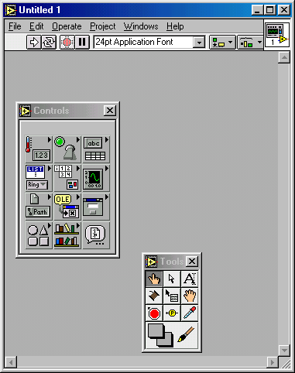
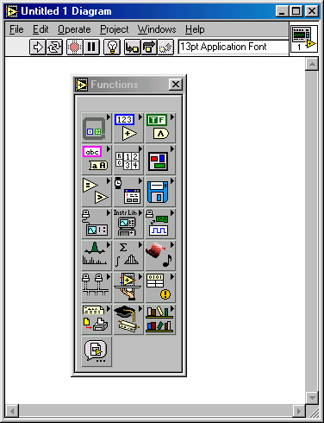
Front Panel & Wiring Diagram.
It is often helpful to view both simultaneously using the Windows-Tile Left and Right command from the pull down menu.
A new (empty) VI is shown below with the key pull-down menu pallets visible.

Slide 28
Modifying a VI
Only one of the two windows (front panel or wiring diagram) is active at any point in time. To activate one simply move the mouse over it and click a mouse button.
To display any of the pallets (tools, controls, or functions) you can use the Windows pull down menu or simply left or right click your mouse.
When you first pull up a pallet an image of a push pin is displayed in the upper left hand corner. Click on it to keep the pallet continuously displayed.

Slide 29
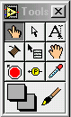
Tools palette . . .
Select a feature to
edit or move
Add/edit text
Operate a control
Probe Data
(troubleshoot)
Wire features together to
control flow of data

Slide 30
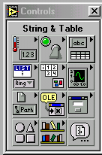
Controls palette . . .
Insert a boolean control
(button or switch)
Insert a digital
indicator or control

Slide 31
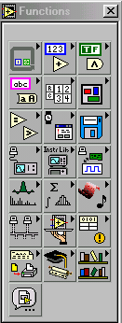
Functions palette . . .
Add a numeric
operator (+,-,…)
Add a structure such as for,
while, and case statements
Add a boolean
operator (and, or…)
Timing/dialog
Comparison
File I/O
Signal analysis
Data Acquisition
Mathematical
Functions

Slide 32
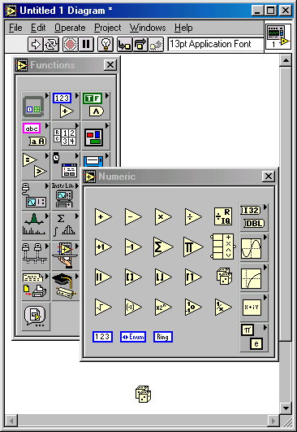
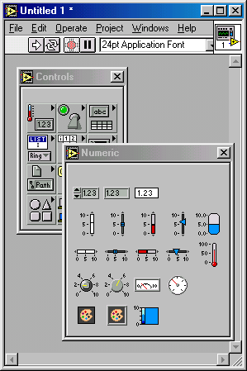
Subpalettes . . .

Slide 33
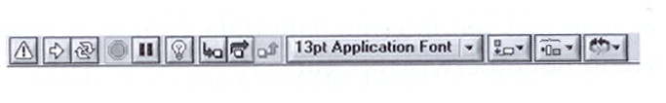
Toolbar . . .
Continuous run
Font ring
Distribution ring
Run
Stop
Pause
Alignment ring
Debugging features
more on this later…
Reorder objects

Slide 34
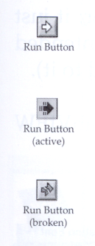
The Run Button
The Run button, which looks like an arrow, starts VI execution when you click on it
It changes appearance when a VI is actually running.
When a VI won’t compile, the run button is broken

Slide 35
Chapter 6:
LabVIEW
Part 3: Examples

Slide 36
Example 1: Craps
From the functions – numeric panel insert a pair of dice
From the Controls panel insert a numeric digital indicator (on the front panel)
Use the wiring tool to connect the two (in the wiring diagram) and click the “run” button repeatedly.
Numbers from 0.00 to 1.00 should be displayed in the front panel

Slide 37
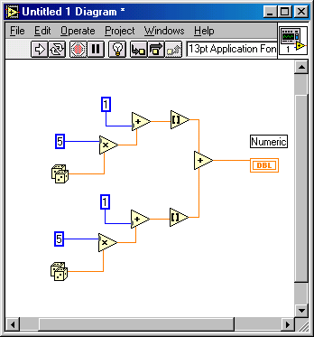
Example 1: Craps (continued)
Delete the wire
Add a multiplication node and a numeric constant to allow multiplication by 5
Add an addition node and numeric constant to allow addition of 1
Add a mathematical “Round to Nearest” node.
Make a second copy of this structure to represent a second die and wire them together through an addition node with an output to a numeric constant
This wiring diagram simulates the rolling
of 2 dice and their addition to form a number
from 2 through 12.

Slide 38
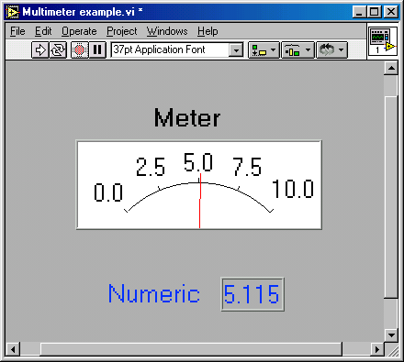
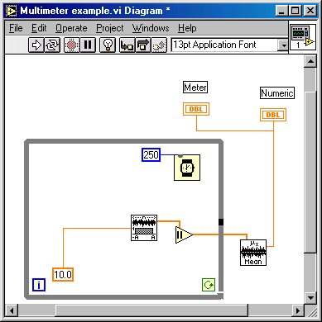
Example 2: Analog & Digital Voltmeter (simulated signal)
Uniform noise used as simulated signal – Functions – Signal Processing – Signal Generation menu
Absolute value function from functions – numeric menu
Mean value of data series from the functions – mathematics – Probability and Statistics menu
The 250 ms wait implemented from the time and dialog menu slows the “flutter” of the meter.

Slide 39
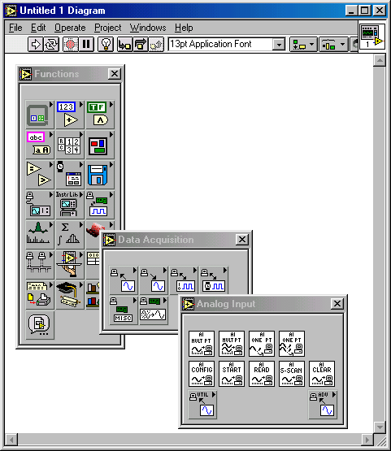
Example 3: Reading an analog input signal
Requires A/D board to implement
From the functions menu select data acquisition and then analog input. Then select either “Sample Channel” or Sample Channels”
This places the sampling icon in your wiring diagram
You then need to configure the channel(s) and wire the output to other parts of your program.

Slide 40
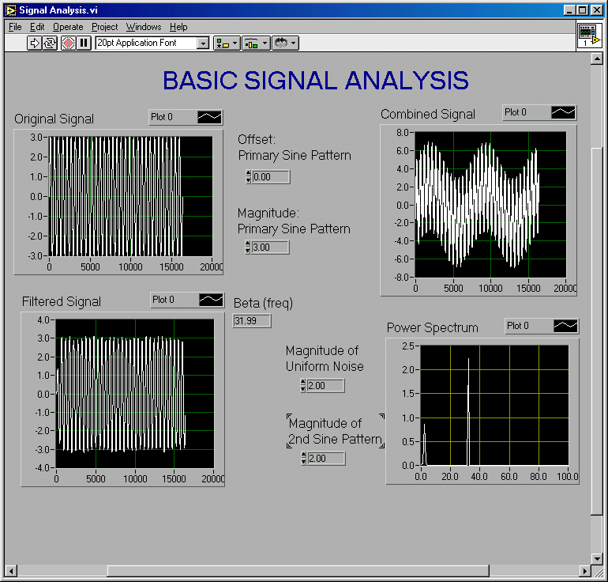
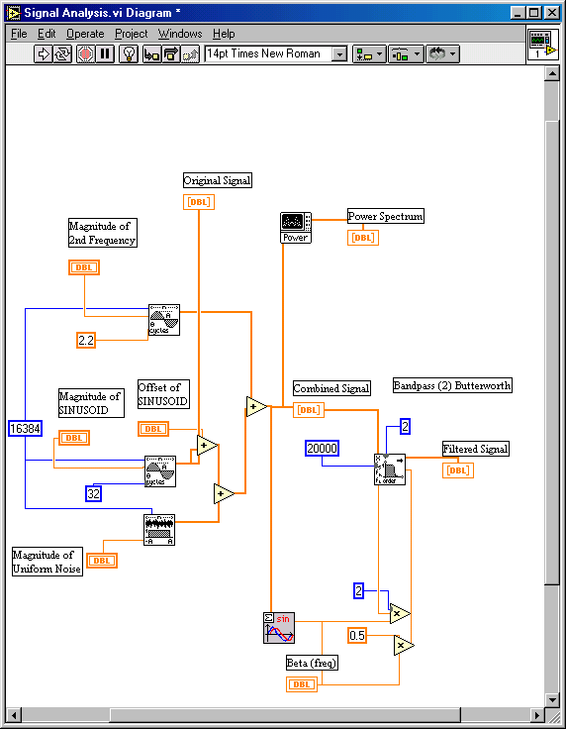
Example 4: Signal Analysis (continued)

Slide 41
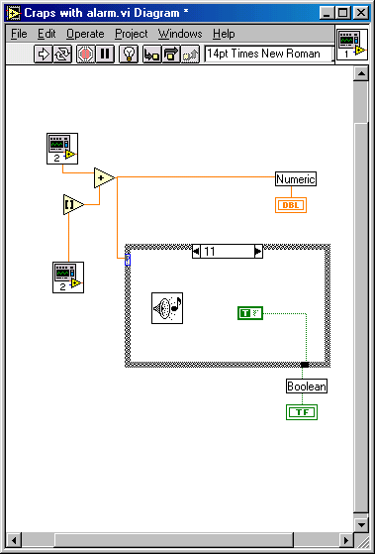
Example 5: Creating Sub-VIs
In wiring diagram use selection tool (mouse box) to select all items to be in the SubVI.
From Edit menu select “Create SubVI”
Double click on new icon and save it as a separate VI.
Cut-and-paste it at will or insert it using “Functions – Select VI menu”

